Slide 1
Two Groups Too Many? Try Analysis of Variance (ANOVA)

Slide 2
Analysis of Variance (ANOVA)
Used when more than two group means are being tested simultaneously
Group means differ from one another on a particular score / variable
Example: DV = GRE Scores & IV = Ethnicity – rather there is a difference in average GRE scores between
Test statistic for one-way analysis of variance= F test

Slide 3
Requirements for Using the F ratio
A comparison between three or more independent means
Interval data
Random sampling
A normal distribution
Equal variance

Slide 4
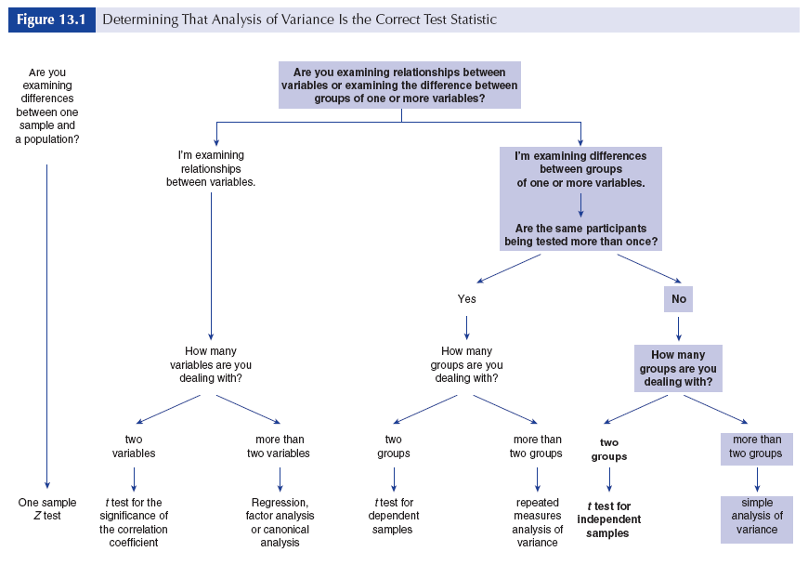
Path to Wisdom and Knowledge
How do I know if ANOVA is the right test?

Slide 5
Different Flavors of ANOVA
ANOVA examines the variance between groups and the variances between individuals within groups
These variances are then compared against each other
Similar to the t test - only in this case we are comparing means between more than two groups
Two components of total variation
Variation within groups→ the distance of raw scores from their group mean
AND
Variation between groups→ the distance or deviation of group means from one another

Slide 6
Different Flavors of ANOVA
One-way ANOVA
Simple ANOVA
Single factor (grouping variable)
Any analysis where:
There is only one dimension or treatment
There are more than two levels of the grouping factor
Looking at differences across groups in average scores

Slide 7
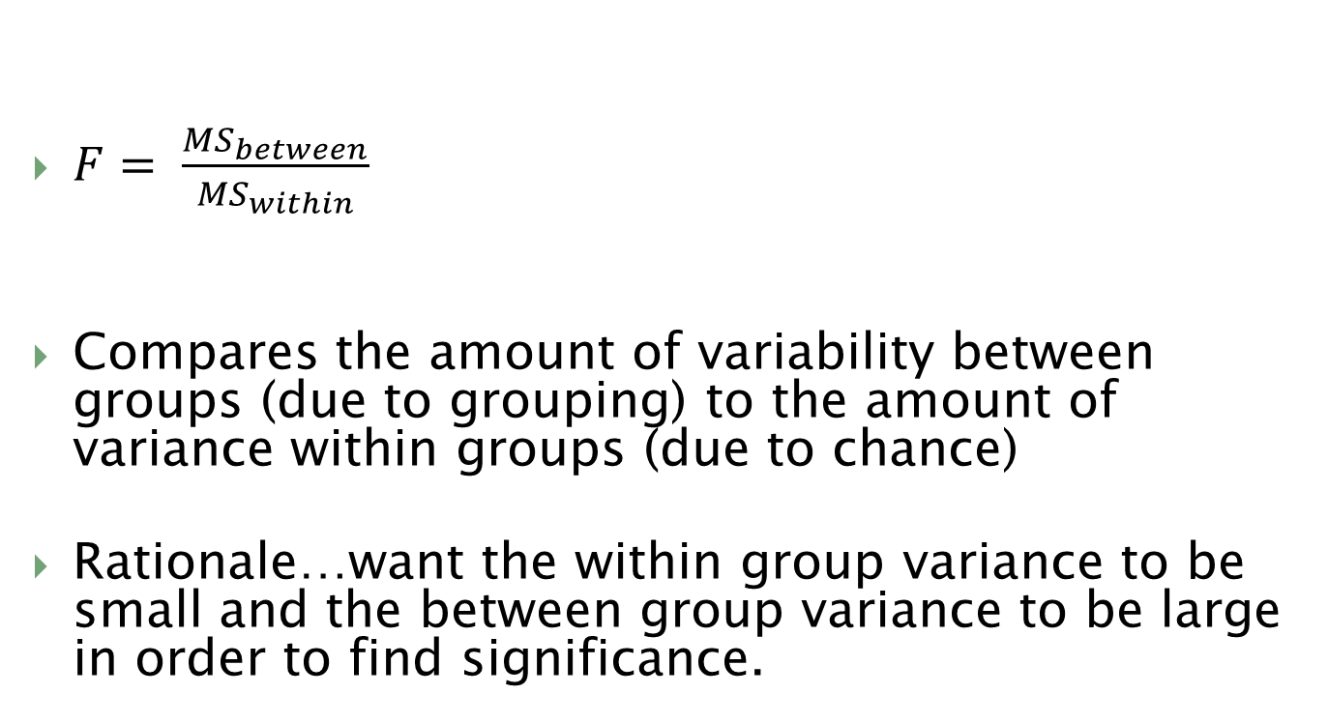
Computing the F Statistic
$F= \frac{{MS}_{between}}{{MS}_{within}}$
Compares the amount of variability between groups (due to grouping) to the amount of variance within groups (due to chance)
Rationale…want the within group variance to be small and the between group variance to be large in order to find significance.

Slide 8
Computing the F statistic
F = MS_{b}
MS_{w}
MS_{b} = SS_{b} / df_{b}
MS_{w} = SS_{w} / df_{w}

Slide 9
Example 1
Is there a significant difference in the number of annual offenses committed by sex offenders, robbers, burglars, and drug offenders?
Sex offenses | Robbery | Burglary | Drugs
1 | 3 | 5 | 4
0 | 1 | 6 | 6
0 | 2 | 4 | 2
2 | 2 | 2 | 5
0 | 1 | 5 | 6

Slide 10

Hypotheses
Null hypothesis
$H_{0}: μ_{1}$ = $μ_{2}$ = $μ_{3}$ = $μ_{4}$
Research hypothesis
$$H_{1}: {\overline{X}}_{1} ≠ {\overline{X}}_{2}≠{\overline{X}}_{3}≠{\overline{X}}_{4}$$

Slide 11
Steps in Hypothesis testing
Setting the level of risk associated with the null hypothesis
The level of risk/significance is .05.
Selection of the appropriate test statistic
We are examining the differences between groups of more than one variable – the same participants are not being tested more than once – we’re dealing with more than two groups – simple analysis of variance is our appropriate test statistic

Slide 12
Steps in Hypothesis Testing
Calculate the group means
x̄₁ = 0.6
x̄₂ = 1.8
x̄₃ = 4.4
x̄₄ = 4.6

Slide 13
Steps in Hypothesis Testing
Sum of Score, Sum of squared scores, number of subjects, and mean for all groups combined
∑X_{total} = ∑X₁ + ∑X₂ + ∑X₃ + ∑X₄
∑X²_{total} = ∑X₁² + ∑X₂² + ∑X₃² + ∑X₄²
N_{total} = N₁ + N₂ + N₃ + N₄
x̄_{total} = ∑X_{total}
N_{total}

Slide 14
Steps in Hypothesis Testing
Sex offenses |  | Robbery |  | Burglary |  | Drugs
X₁ | X² | X₂ | X² | X₃ | X² | X₄ | X²
1 | 1 | 3 | 9 | 5 | 25 | 4 | 16
0 | 0 | 1 | 1 | 6 | 36 | 6 | 36
0 | 0 | 2 | 4 | 4 | 16 | 2 | 4
2 | 4 | 2 | 4 | 2 | 4 | 5 | 25
0 | 0 | 1 | 1 | 5 | 25 | 6 | 36
∑X_{total} = 3 + 9+ 22 + 23 = 57
∑X²_{total} = 5 + 19 + 106 + 117 = 247
N_{total} = 5 + 5 + 5 + 5 = 20
x̄_{total} = 57/20 = 2.85

Slide 15
Steps in Hypothesis Testing
Calculate the WITHIN Sum of Squares
The within group sum of squares is equal to the sum of the differences between each individual score in a group and the mean of each group, which is then squared.
Tells us how different each score in a group is from the mean of that group.
SS_{w} = ∑X²_{total} - ∑ N_{group} x̄ ²_{group}
SS_{w} = 247 - [(5) (.6)² + (5) (1.8)² + (5)(4.4)² + (5)(4.6)²]
SS_{w} = 247 - [(5) (.36) + (5) (3.24) + (5)(19.36) + (5)(21.16)]
SS_{w} = 247 - [1.8 + 16.2 + 96.8+ 105.8]
SS_{w} = 247 - 220.6
SS_{w} = 26.4

Slide 16
Steps in Hypothesis Testing
Calculate the BETWEEN Sum of Squares
The between group sum of squares is the sum of the differences between the mean of all scores and the mean of each group’s scores, which is then squared.
Tells us how different each group’s mean is grom the overall mean.
SS_{b} = ∑ N_{group} x̄ ²_{group} - N_{total} x̄ ²_{total}
SS_{b} = 220.6 – (20) (2.85)²
SS_{b} = 220.6 - 162.4
SS_{b} = 58.1

Slide 17
Steps in Hypothesis Testing
Calculate the BETWEEN-GROUP degrees of freedom
df_{b} = k-1
k= total # of groups
In this case, there are 4 groups (sex offenders, robbers, burglars, and drug offenders)
df_{b} = k-1
df_{b} =4-1
df_{b} = 3

Slide 18
Steps in Hypothesis Testing
Calculate the WITHIN-GROUP degrees of freedom
df_{w} = N_{total} - k
N = total group participants across groups
k = total # of groups
df_{w} = N_{total} - k
df_{w} =20-4
df_{w} = 16

Slide 19
Steps in Hypothesis Testing
Calculate the WITHIN and BETWEEN groups mean square
MS_{w} = SS_{w} / df_{w}
MS_{w} = 26.4 / 16
MS_{w} = 1.65
MS_{b} = SS_{b} / df_{b}
MS_{b} = 58.1 / 3
MS_{b} = 19.37

Slide 20
Steps in Hypothesis Testing
Calculate F statistic
F_{o} = MS_{b}
MS_{w}
F_{o} = 19.37 / 1.65
F_{o} = 11.74

Slide 21
Steps in Hypothesis Testing
Determine if significant
Go to Table B3 (pg356)
Numerator = df_{b} = 3
Denominator = df_{w} = 16
Find F_{c} value needed to exceed in order to reject the null at 0.05 significance level

Slide 22
Steps in Hypothesis testing
Comparison of the obtained value and the critical value
Obtained value is 11.74 and the critical value for rejection of the null hypothesis at the .05 level that the three groups are different from one another is 3.24
Decision
F_{o} > F_{c} (11.74>3.24)
The obtained value is more extreme than the critical value (11.74>3.24) so we can say the difference between the 4 groups is not due to chance alone. Therefore, reject the null hypothesis of no difference. There ARE significant differences across these 4 groups. Rather, there is a significant difference in the average annual commission of criminal acts based on type of crime committed.

Slide 23
How to Interpret
F _{(3,16)} = 11.74, p < .05
F = test statistic
3, 16 = df between groups & df within groups
11.74 = obtained value
Which we compared to the critical value
p < .05 = probability less than 5% that the null hypothesis is true

Slide 24
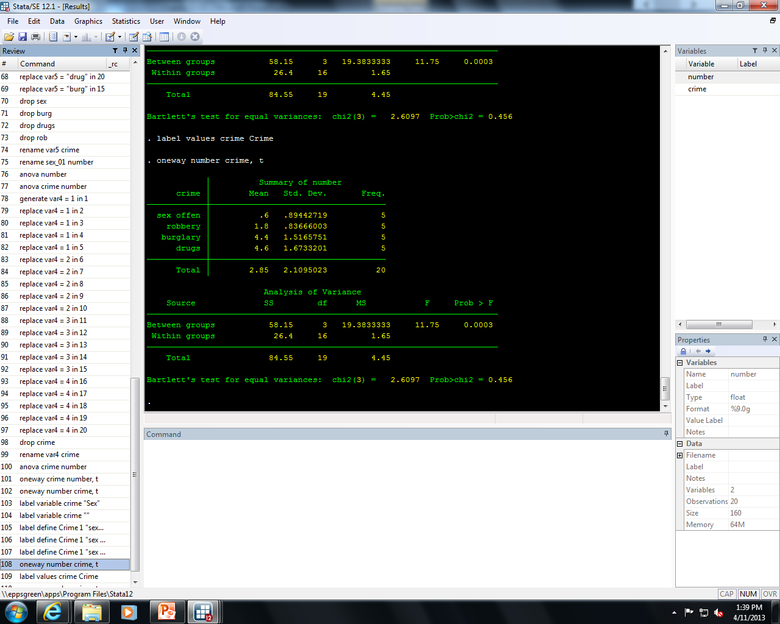
Stata output

Slide 25
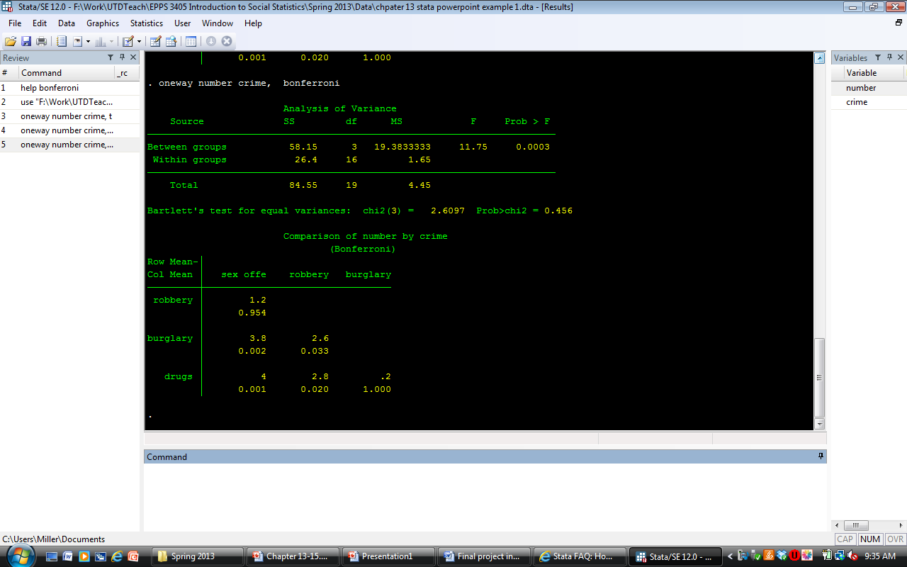
Post hoc test
Where do the differences lie?

Slide 26
Example 2
Is there a significant difference in the average performance of 8th, 10th and 12th graders on math a proficiency exam?
8th grade | 10th grade | 12th grade
97 | 98 | 89
95 | 85 | 87
87 | 83 | 96
74 | 89 | 95
85 | 75 | 97
56 | 92 | 98
66 | 78 | 99
73 | 83 | 93
98 | 82 | 92
92 | 87 | 89

Slide 27

Hypotheses
Null hypothesis
$H_{0}: μ_{1}$ = $μ_{2}$ = $μ_{3}$
Research hypothesis
$$H_{1}: {\overline{X}}_{1} ≠ {\overline{X}}_{2}≠{\overline{X}}_{3}$$

Slide 28
Steps in Hypothesis testing
Setting the level of risk associated with the null hypothesis
The level of risk/significance is .05.
Selection of the appropriate test statistic
We are examining the differences between groups of more than one variable – the same participants are not being tested more than once – we’re dealing with more than two groups – simple analysis of variance is our appropriate test statistic

Slide 29
Steps in Hypothesis testing – computing the test statistic

Slide 30
Steps in Hypothesis testing
Determination of the value needed for rejection of the null hypothesis using the appropriate table of critical values - using table B.3
Degrees of freedom between (numerator)
Number of groups minus one
k-1
3 groups --- 3 – 1 = 2
Degrees of freedom within (denominator)
Total number of observations minus the number of groups
N-k
30 – 3 = 27
Represented: F _{(2, 27)}
2 degrees of freedom in the numerator and 27 in the denominator = critical value 3.36

Slide 31
Steps in Hypothesis testing
Comparison of the obtained value and the critical value
Obtained value is 3.76 and the critical value for rejection of the null hypothesis at the .05 level that the three groups are different from one another is 3.36
Decision
The obtained value is more extreme than the critical value (3.76>3.36) so we can say the difference between the 3 groups is not due to chance alone and that there is a significant difference in performance on the math proficiency exam between 8th, 10th and 12th graders

Slide 32
How to Interpret
F _{(2,27)} = 3.76, p < .05
F = test statistic
2, 27 = df between groups & df within groups
3.76= obtained value
Which we compared to the critical value
p < .05 = probability less than 5% that the null hypothesis is true

Slide 33
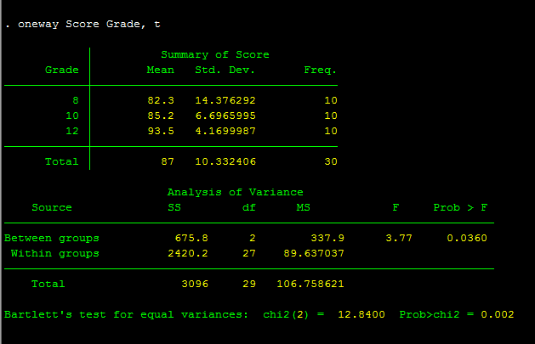
Stata output

Slide 34
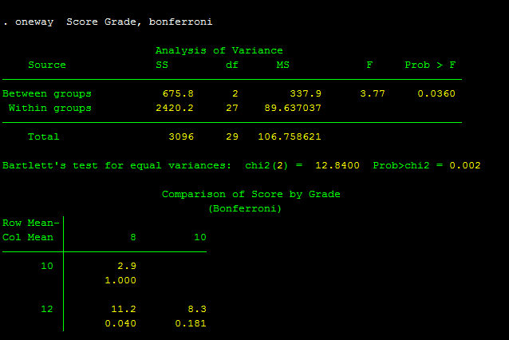
Post hoc test
Where does the difference lie?

Slide 35
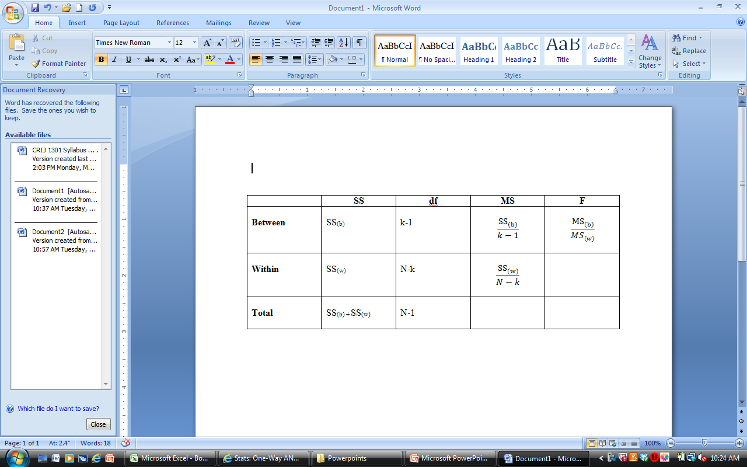
Remember
Post hoc tests are needed to determine where the difference lies and the degree of difference between groups
The F test is an “omnibus test” in that it only tells you that a difference between groups exists

Slide 36
Chapter 15 Cousins or Just Good Friends? Testing Relationships Using the Correlation Coefficient
☺ ☺ ☺ ☺
EPPS 3405

Slide 37
Overview
How to test the significance of the correlation coefficient
The interpretation of the correlation coefficient
The distinction between significance and meaningfulness

Slide 38
Strength of Correlation
Finding that a relationship exists does not indicate much about the degree of association (correlation) between the two variables
Correlations vary with respect to their strength
Differences in the strength of correlations can be seen visually using a scatter plot or scatter diagram
Closer together = stronger

Slide 39
Direction of Correlation
Positive or negative
Positive correlation indicates that respondents getting high scores on the X variable also tend to get high score on the Y variable
Negative correlation exists if respondents who obtain high scores on the X variable tend to obtain low scores on the Y variable

Slide 40
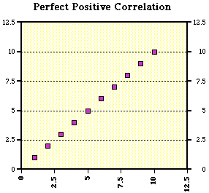
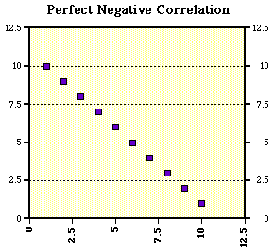
Perfect Correlations

Slide 41
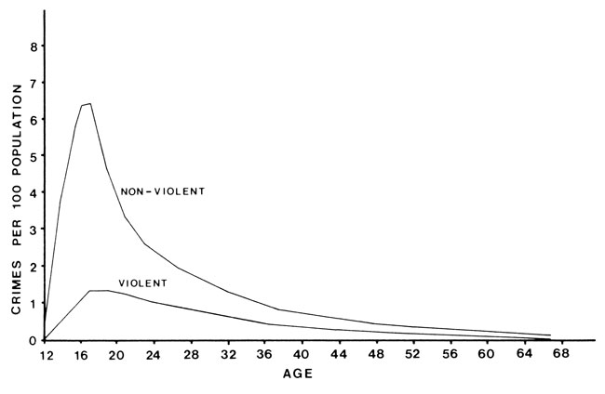
Curvilinear Correlation
Criminal justice researchers usually seek to establish a straight-line correlation (positive or negative)
Curvilinear relationships→ indicate that one variable increases as the other variable increases until the relationship reverses itself so that one variable finally decreases while the other continues to increase
Example: the Relationship between Age (X) and Crime (Y)

Slide 42
Correlation Coefficient
Correlation coefficients→ numerically express both the strength and direction of straight-line correlation
As the correlation approaches the absolute value of 1, the stronger the relationship
Size of the Correlation | Coefficient General Interpretation
.8 to 1.0 | Very strong relationship
.6 to .8 | Strong relationship
.4 to .6 | Moderate relationship
.2 to .4 | Weak relationship
.0 to .2 | Weak or no relationship

Slide 43
Pearson’s (r) Correlation Coefficient
Used to determine the strength and the direction of the relationship between X and Y variables, both of which have been measured at the interval level
Example: What is the direction and strength of the relationship between years of education (X) and belief that drug treatment is effective [using a 20 point scale] (Y)

Slide 44
The Correlation Coefficient
Remember…correlations examine the relationship between variables, they do not attempt to determine causation
Examine the “strength” of the relationship
Range from -1 to +1
Direct relationships
Positive correlations
Indirect relationships
Negative correlations
Sensitive to outliers
For use with interval level data only

Slide 45
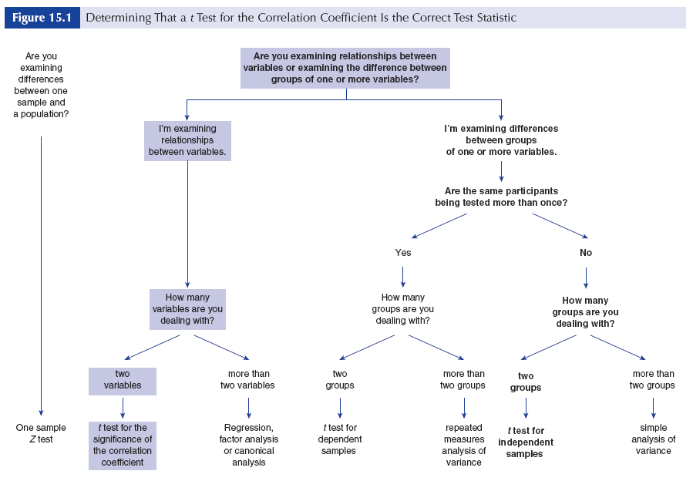
Path to Wisdom and Knowledge

Slide 46
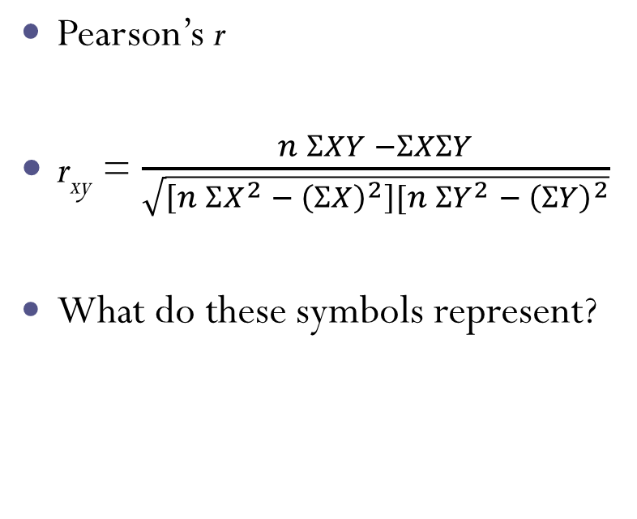
Computing the Test Statistic
Use the Pearson formula to determine if there is a significant relationship between age and average nightly hours slept
H₀: ρ_{xy} = 0 H₁: r_{xy} ≠ 0
Notes:
Example using data page 256 of text

Slide 47
Pearson’s r Continued…
Age | Hours slept | X² | Y² | XY
12 | 12 |  |  |  | N =
10 | 8 |  |  |  | ∑ X =
6 | 12 |  |  |  | ∑ Y =
16 | 11 |  |  |  | X =
8 | 10 |  |  |  | Y =
9 | 8 |  |  |  | ∑ X² =
12 | 16 |  |  |  | ∑ Y² =
11 | 15 |  |  |  | ∑ XY =

Slide 48
Pearson’s r Continued…
Age | Hours slept | X² | Y² | XY
12 | 12 |  |  |  | N = 8
10 | 8 |  |  |  | ∑ X = 84
6 | 12 |  |  |  | ∑ Y = 92
16 | 11 |  |  |  | X = 10.5
8 | 10 |  |  |  | Y = 11.5
9 | 8 |  |  |  | ∑ X² =
12 | 16 |  |  |  | ∑ Y² =
11 | 15 |  |  |  | ∑ XY =
84 | 92

Slide 49
Pearson’s r Continued…
Age | Hours slept | X² | Y² | XY
12 | 12 | 144 |  |  | N = 8
10 | 8 | 100 |  |  | ∑ X = 84
6 | 12 | 36 |  |  | ∑ Y = 92
16 | 11 | 256 |  |  | X = 10.5
8 | 10 | 64 |  |  | Y = 11.5
9 | 8 | 81 |  |  | ∑ X² = 946
12 | 16 | 144 |  |  | ∑ Y² =
11 | 15 | 121 |  |  | ∑ XY =
84 | 92 | 946

Slide 50
Pearson’s r Continued…
Age | Hours slept | X² | Y² | XY
12 | 12 | 144 | 144 |  | N = 8
10 | 8 | 100 | 64 |  | ∑ X = 84
6 | 12 | 36 | 144 |  | ∑ Y = 92
16 | 11 | 256 | 121 |  | X = 10.5
8 | 10 | 64 | 100 |  | Y = 11.5
9 | 8 | 81 | 64 |  | ∑ X² = 946
12 | 16 | 144 | 256 |  | ∑ Y² = 1118
11 | 15 | 121 | 225 |  | ∑ XY =
84 | 92 | 946 | 1,118

Slide 51
Pearson’s r Continued…
Age | Hours slept | X² | Y² | XY
12 | 12 | 144 | 144 | 144 | N = 8
10 | 8 | 100 | 64 | 80 | ∑ X = 84
6 | 12 | 36 | 144 | 72 | ∑ Y = 92
16 | 11 | 256 | 121 | 176 | X = 10.5
8 | 10 | 64 | 100 | 80 | Y = 11.5
9 | 8 | 81 | 64 | 72 | ∑ X² = 946
12 | 16 | 144 | 256 | 192 | ∑ Y² = 1,118
11 | 15 | 121 | 225 | 165 | ∑ XY = 981
84 | 92 | 946 | 1,118 | 981

Slide 52
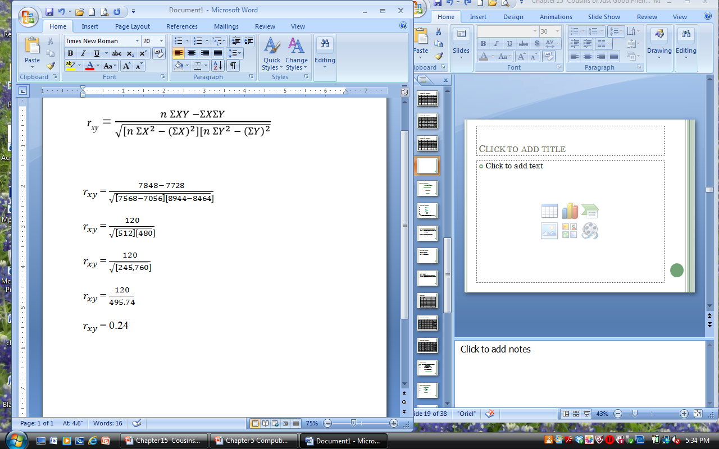
Example Continued
***There is a modest positive correlation between age and hours slept

Slide 53
Testing the Significance of Pearson’s r
To test the significance of a measure correlation we usually set up the null hypothesis that no correlation exists in the population
Whereas the research hypothesis says that

Slide 54
Critical value of r
Table 4 pg. 362 (0.05 level; two-tailed test)
df = N-2
df = 8-2 = 6
Critical r value = 0.7067

Slide 55
Conclusion
0.24 < 0.7067
Fail to reject the null, there’s no statistically significant correlation between age and number of hours slept

Slide 56
Causes and Associations
Just because two variables are related has no bearing on whether there is a causal relationship.
Example:
Quality marriage does not ensure a quality parent-child relationship
Two variables may be correlated because they share something in common…but just because there is an “association” does not mean there is “causation.”

Slide 57
Significance Versus Meaningfulness
Even if a correlation is significant, it doesn’t mean that the amount of variance accounted for is meaningful.
Example
Correlation of .44
Variance accounted for: .194 or 19.4%
81.6% remaining!!!

Slide 58
References
Agresti, Alan and Barbara Finlay (2008). Statistical Methods for the Social Sciences, 4th edition. Upper Saddle, NJ: Prentice-Hall.
Salkind, Neil J. (2010). Statistics for People Who Think They Hate Statistics, 4th edition. Thousand Oaks, CA: Sage Publications.

